Slide 1

CAR POOLING SYSTEM
ADHIDHYA S Y
S3 MCA

Slide 2
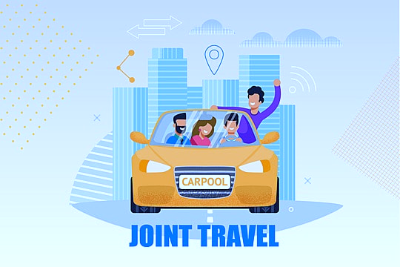
AGENDA
Introduction of car pooling system
Existing System
Proposed System
Product Backlog
Conclusion

Slide 3

INTRODUCTION
The car pooling system is…..
An web application.
User friendly interface for easy ride matching.
Creation of car pooling system to allow commuters to share they travel costs and journeys.
By connecting poolers and user traveling to similar destinations .
It’s cost-effective, eco-friendly, and social mode of transportation.
The benefits are reducing the traffic congestion, air pollution, and fuel consumption.

Slide 4

EXISTING SYSTEM
Limitations of Present System are
Uber’s added value is in the concept of ride on demand .
sometimes it may be the same price as a taxi service.
You won’t have much freedom or flexibility with your schedule and activators.

Slide 5
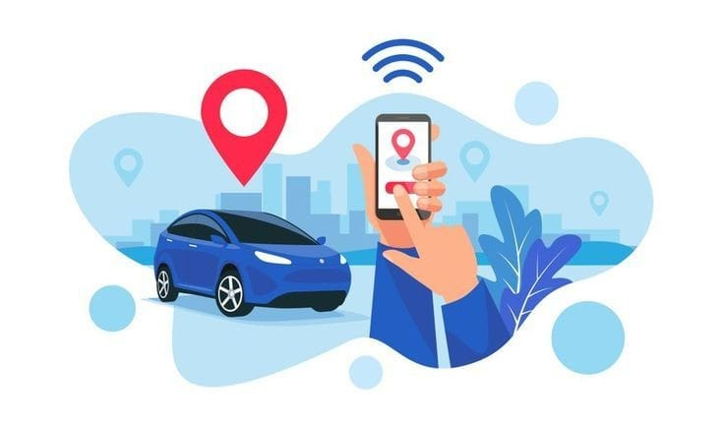
PROPOSED SYSTEM
The proposed car pooling system will provides…
Allows commuters to search for registered members based on location (use google maps).
Filter searches by gender and age.
contact matches via private messaging or mobile messaging.
Block unwanted matches
Log in to a web application for authentication and secrecy.
The CPS aims to promote carpooling by targeting small niches, making it easier for people to use the system.

Slide 6
PRODUCT BACKLOG
ID | Feature | User Story | Priority | Status
1. | Login Management
1.1 |  | As an Admin, I want to login and update details | Normal
1.2 |  | As a Pooler (driver), I want to login and update details | Normal
1.3 |  | As a User, I want to Register, login and update details | High

Slide 7
ID | Feature | User Story | Priority | Status
2. | Admin management
2.1 |  | As an Admin, I want to Approve, Delete and View Pooler Details | Normal
2.2 |  | As an Admin, I want to Approve, Delete and User (students)Details | Normal
2.3 |  | As an Admin, I want to reply complaints to user and poolers | Low
2.4 |  | As an Admin, I want to approve or deny pools | Normal
2.5 |  | As an Admin, I want to View pool details | Normal

Slide 8
ID | Feature | User Story | Priority | Status
3. | Pooler Management
3.1 |  | As a Pooler, I want to Create pools | High
3.2 |  | As a Pooler, I want to View Pool members | High
3.3 |  | As a Pooler, I want to View pool rating | High
3.4 |  | As a Pooler, I want to update details | Normal
3.5 |  | As a Pooler, I want to view pool members | Normal
3.6 |  | As a Pooler, I want to send and reply messages to users | High

Slide 9
ID | Feature | User Story | Priority | Status
4. | User Management
4.1 |  | As a User, I want to search Pool | Very high
4.2 |  | As a User, I want to Join pool | Very high
4.3 |  | As a User, I want to Rate pools | Very high
4.4 |  | As a User, I want to View Pool members | High
4.5 |  | As a User, I want to send messages to pooler and admin | Very high

Slide 10

CONCLUSION
I want to solve traffic and transportation problems with our new system.
My new system will be better than what exists now.
I will test and improve our system to make it the best it can be.
My goal is to make carpooling easy, safe, and popular.

Slide 11
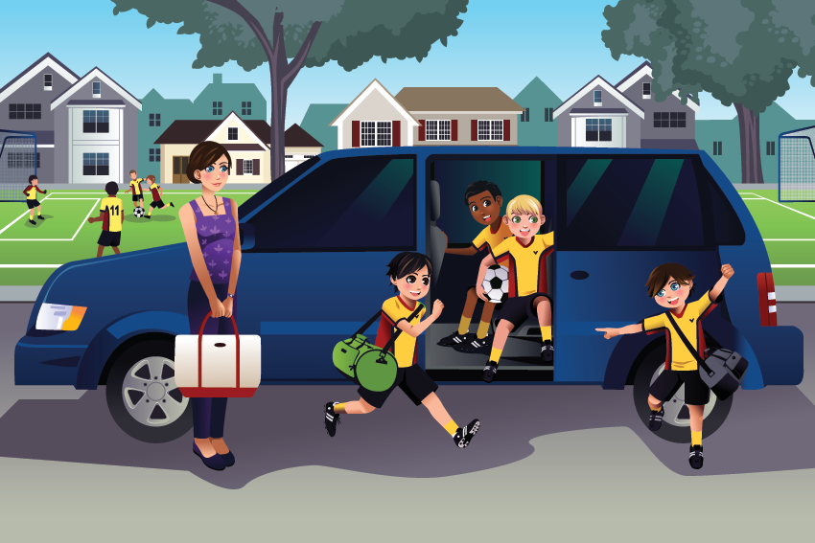
THANK YOU

